Slide 1
PSCS_4:Use of Digital Technology to calculate water footprints for different daily use items.
CSE7101- Capstone Project
Review-1
Batch Number: ISE_3
Under the Supervision of,
Dr.Mohammadi Akheela Khanum
Dr.Swati Sharma
School of Computer Science and Engineering
Presidency University
Roll Number | Student Name
20221ISE0012 | MUSKAN
20221ISE0078 | KEERTHANA M
20221ISE0057 | JINKA VEDA SREE
Name of the Program: ISE(Information science and Engineering)
Name of the HoD: Dr. Zafar Ali Khan N
Name of the Program Project Coordinator: Ms. Suma N G
Name of the School Project Coordinators: Dr. Sampath A K , Dr. Geetha A

Slide 2
Problem Statement Number: PSCS_4
Organization: Presidency University
Category :Software
Problem Description:Use of Digital Technology to calculate water footprints for different daily use items.

Slide 3
Content
Problem Statement
Objectives
Background and Related work for title Selection
Analysis of Problem Statement
Innovation or Novel Contributions
Git-hub Link
Timeline of the Project
References

Slide 4
Objectives
Topic:
Use of Digital Technology to calculate water footprints for different daily use items.
To develop and implement a digital solution that accurately calculates the water footprint of various daily use items by integrating reliable datasets, computational algorithms, and user-friendly interfaces, with the aim of increasing public awareness, promoting sustainable consumption habits, and supporting data-driven decision-making for water conservation.

Slide 5
Background and Related work for title Selection
Background
Water is a finite and essential natural resource, yet global demand continues to rise due to population growth, industrialization, and changing lifestyles. A significant portion of water consumption is embedded in the production and usage of daily items—ranging from food and clothing to household goods. This embedded usage, often referred to as the water footprint, includes direct water use (e.g., drinking, cooking) and indirect water use (e.g., irrigation for crops, water used in manufacturing processes).
Related work
In terms of related work, organizations like the Water Footprint Network and FAO’s AQUASTAT provide global datasets and calculators, and platforms like WaterCalculator.org give general estimates for individuals. Some research has used IoT-based smart meters to measure actual household water use, while others have applied machine learning to predict water consumption patterns. However, most existing solutions rely on static data and lack real-time, localized, item-specific calculations. This gap motivated me to select this title, as my work aims to integrate digital tools to make the water footprint calculation more dynamic, accurate, and user-friendly.

Slide 6
Analysis of Problem Statement
Technology Stack Components:
Development Plan
Technology stack:
Frontend: React, Vue, or simple HTML/CSS/JavaScript for user interface
Backend (optional): Python/Node.js to handle calculations and data management
Database: Store water footprint data (e.g., JSON files or a simple database)
→What’s a Water Footprint?
It’s the total volume of freshwater used directly and indirectly to produce an item. For example, a cup of coffee’s water footprint includes water used to grow the coffee beans, process them, and brew the coffee.
→Why Digital Technology?
Digital tools can make calculating water footprints faster, more accurate, and accessible to many people. This could be an app, a website, or software.

Slide 7
Innovation or Novel Contributions
Calculates water footprint for specific daily items instead of just giving a general total.
Uses real-time or region-based data for more accurate results.
Shows results with easy-to-understand charts and visuals.
Gives simple tips to help users reduce their water usage.

Slide 8
Github Link
The Github link provided should have public access permission.
Github Link

Slide 9
Analysis of Problem Statement (contd...)
Software and Hardware Requirements:
Software Requirements
OS: Windows 10/11, macOS, or Linux
Language & Frameworks: Python (Flask/Django) or Node.js (Express) + Angular.js
Database: MySQL
Tools: VS Code / PyCharm, Git
Libraries: Pandas, NumPy, Chart.js / D3.js
Browser: Chrome / Firefox
Hardware Requirements
Development: i5 Processor, 8 GB RAM, 256 GB SSD, stable internet
Server/Deployment: Quad-core CPU, 8 GB RAM, 256+ GB SSD,Windows Server
Cloud Option: AWS / Azure

Slide 10
Analysis of Problem Statement (contd...)
Expected Outcomes
A functional digital water footprint calculator tool
Increased awareness among users about water consumption in daily life
Suggestions for reducing water footprints tailored to user inputs

Slide 11
Challenges & Considerations
Variability of water footprint data depending on location and production methods
Keeping the tool user-friendly while including detailed data
Ensuring accurate, up-to-date data sources

Slide 12
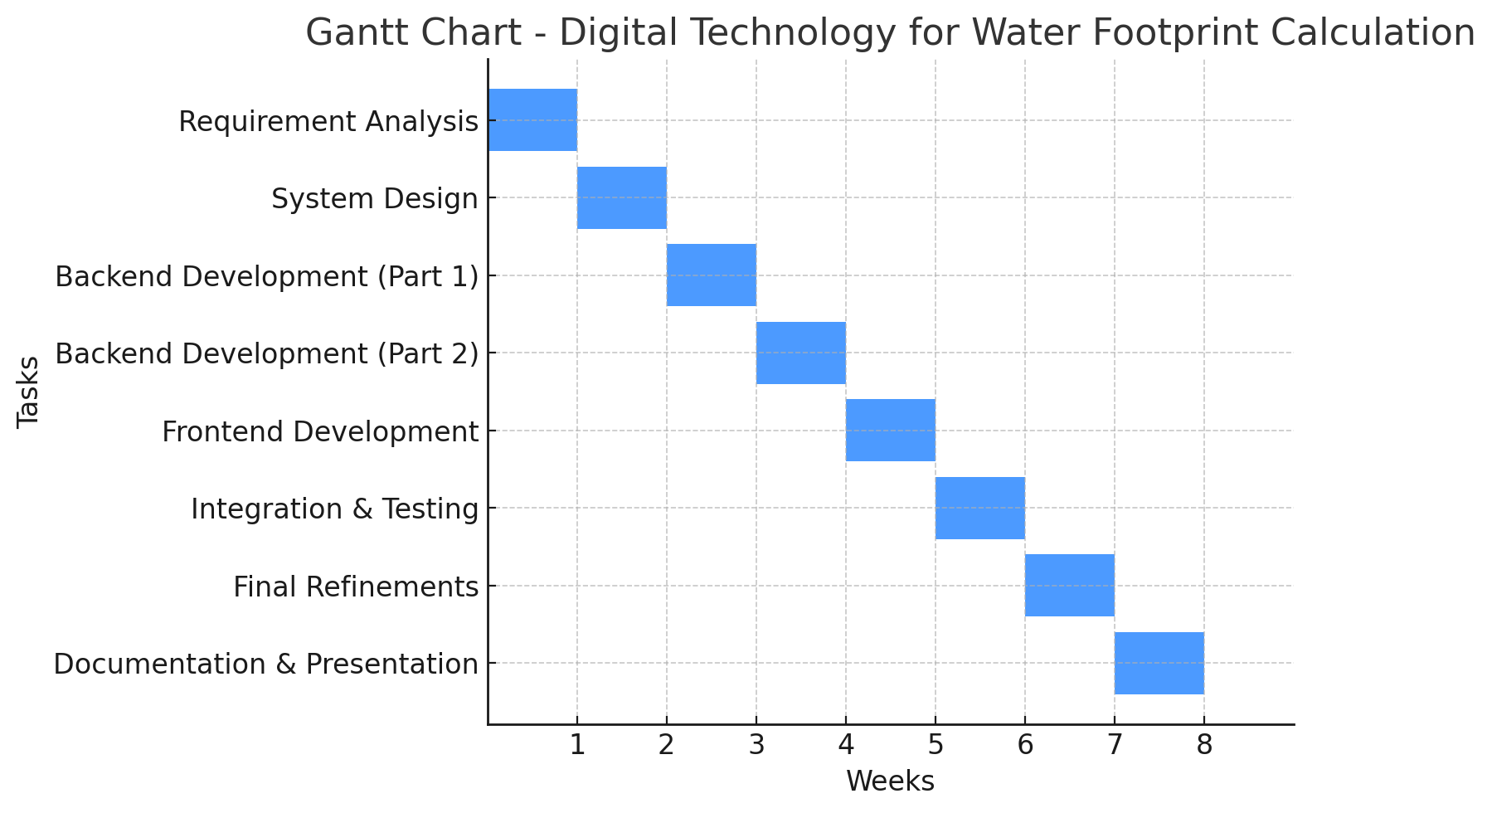
Timeline of the Project (Gantt Chart)

Slide 13
References (IEEE Paper format)
[1]. Hoekstra, A.Y., Chapagain, A.K., Aldaya, M.M., & Mekonnen, M.M. (2011). The Water Footprint Assessment Manual: Setting the Global Standard. Earthscan, London, UK.
[2]. FAO AQUASTAT. (2024). Global Water Information System. Food and Agriculture Organization of the United Nations. Retrieved from: https://www.fao.org/aquastat
[3]. Gleick, P.H. (2014). Water, Drought, Climate Change, and Conflict in Syria. Weather, Climate, and Society, 6(3), 331–340. doi:10.1175/WCAS-D-13-00059.1
[4]. Gleick, P.H. (2014). Water, Drought, Climate Change, and Conflict in Syria. Weather, Climate, and Society, 6(3), 331–340. doi:10.1175/WCAS-D-13-00059.1

Slide 14


